Slide 1
Lecture 11 Perceptron
Abrar Hasan
Lecturer
Dept. of Software Engineering

Slide 2
1
Perceptron
<
T
1
>

Slide 3
Perceptron
<
T
1
>
The Perceptron is the simplest form of a neural network model, serving as a binary linear classifier. It's designed to separate data into two classes by finding a hyperplane (a line in 2D, plane in 3D, etc.) that divides the data.

Slide 4

Perceptron
<
T
1
>
b
w1
x1
x2
w2
x3
w3

Slide 5
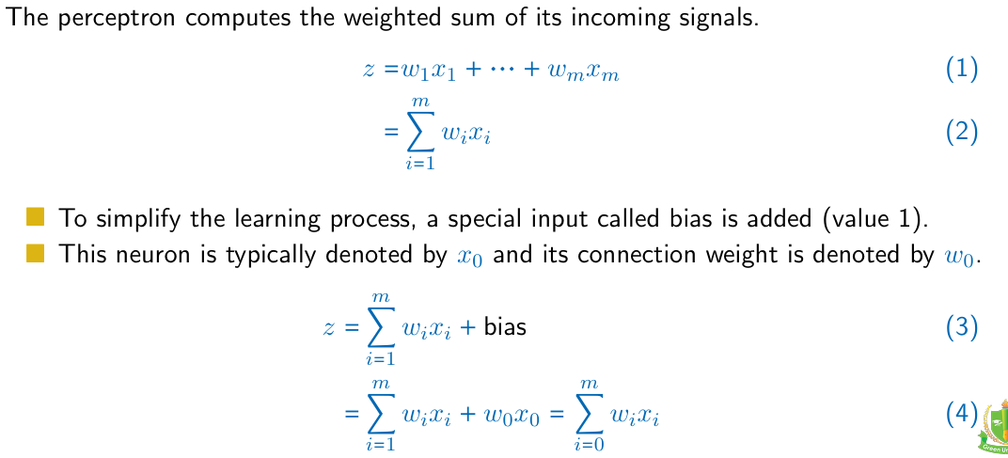
Perceptron
<
T
1
>

Slide 6
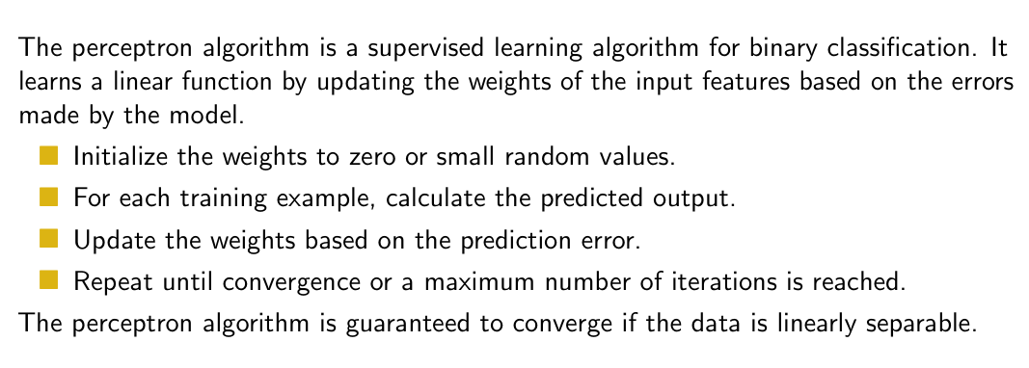
Perceptron
<
T
1
>

Slide 7
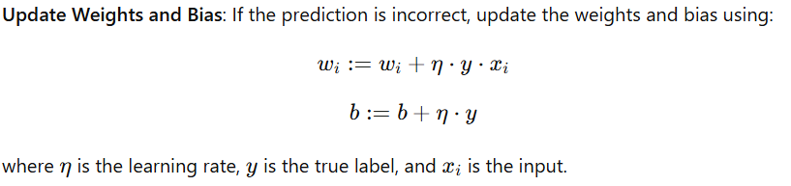
Perceptron
<
T
1
>

Slide 8
Perceptron
<
T
1
>
X1 | X2 | Output
1 | 1 | 1
-1 | 1 | -1
1 | -1 | -1
-1 | -1 | -1

Slide 9

Perceptron
<
T
1
>
W1 = w2= b=0
b
X1 | X2 | Output
1 | 1 | 1
-1 | 1 | -1
1 | -1 | -1
-1 | -1 | -1
w1
x1
w2
x2

Slide 10
Perceptron
<
T
1
>
W1 = w2= b=0
b=0
X1 | X2 | Output
1 | 1 | 1
-1 | 1 | -1
1 | -1 | -1
-1 | -1 | -1
Predicted Value
-1
1
W1 =0
W2=0
1
x₁w₁+x₂w₂+b
= 1 * 0+ 1*0+0
=0

Slide 11
Perceptron
<
T
1
>
So Update the weights
w_{1new}= w_{1old} + (learning Rate) (y)(x₁)
= 0 + (1) (1) (1)
= 1
X1 | X2 | Output
1 | 1 | 1
-1 | 1 | -1
1 | -1 | -1
-1 | -1 | -1
w_{2new}= w_{2old} + (learning Rate) (y)(x₂)
= 0 + (1) (1) (1)
= 1
B_{new}= w_{old} + (learning Rate) (y)
= 0 + (1) (1)
= 1

Slide 12
Perceptron
<
T
1
>
So Update the weights
w_{1new} = 1
w_{2new} = 1
B_{new} =1
X1 | X2 | Output
1 | 1 | 1
-1 | 1 | -1
1 | -1 | -1
-1 | -1 | -1
x₁w₁+x₂w₂+b
= 1 * 1+ 1*1+1
=3
After Sigmoid Predicted Value = 1
Actual Output = -1
So update the weights

Slide 13
2
Multilayer Perceptron
<
T
1
>

Slide 14
Multilayer Perceptron
<
T
1
>
A multilayer perceptron represents an adaptable model y(x,w) able to map D-dimensional input to C-dimensional output
D Dimensional Input
C Dimensional Output
Multiple Layers

Slide 15
Multilayer Perceptron
<
T
1
>
In general, a (L + 1)-layer perceptron consists of (L + 1) layers, each layer l computing linear combinations of the previous layer (l − 1) (or the input).
D Dimensional Input
C Dimensional Output
Multiple Layers

Slide 16
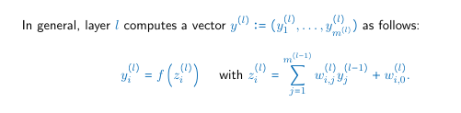

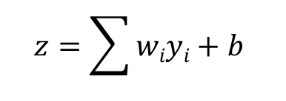

<
T
1
>
b
W1
$y=$f(z)
W2
$$z=\sum{wiyi+b}$$

Slide 17
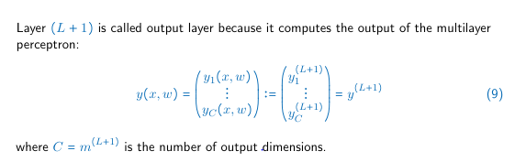
<
T
1
>
D Dimensional Input
C Dimensional Output
Multiple Layers

Slide 18
2
Activation Function
<
T
1
>

Slide 19
Activation Function
D Dimensional Input
C Dimensional Output
Multiple Layers

Slide 20
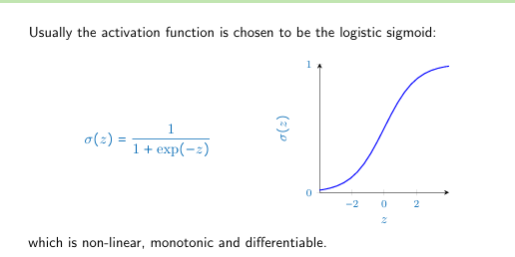
Activation Function

Slide 21
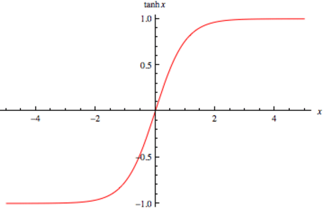
Activation Function
f(z) = tanh(z).

Slide 22
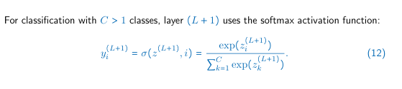
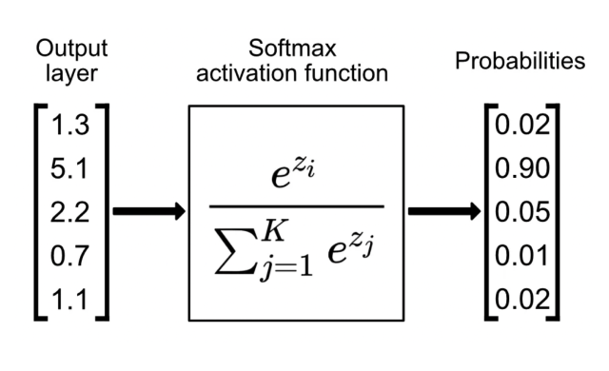
Activation Function

Slide 23
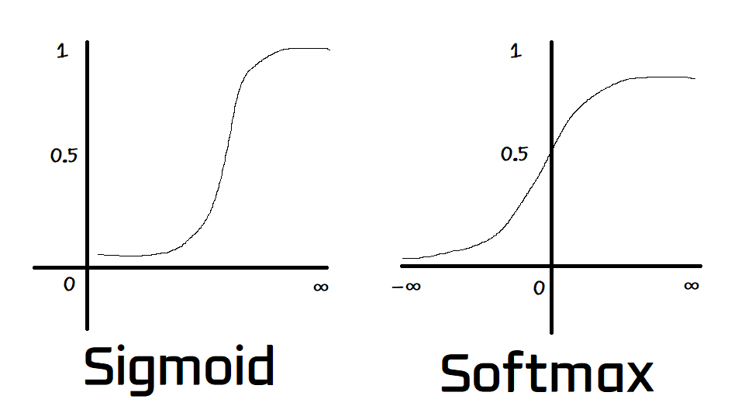
Activation Function

Slide 24
Homework
How do we choose activation Function in each layer? With example?
Why do we need multiple type of Activation Function? Work of different activation function With example

Slide 25
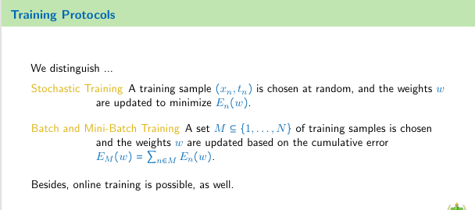

Slide 26
Thank You

